Slide 1


SMART INDIA HACKATHON 2024
TITLE PAGE
Problem Statement ID – 1728
Problem Statement Title – Development of a Paperless Scholarship Disbursement System for PMSSS
Theme - Miscellaneous
PS Category- Software
Team ID -
Team Name (Registered on portal) – Green Grants

Slide 2
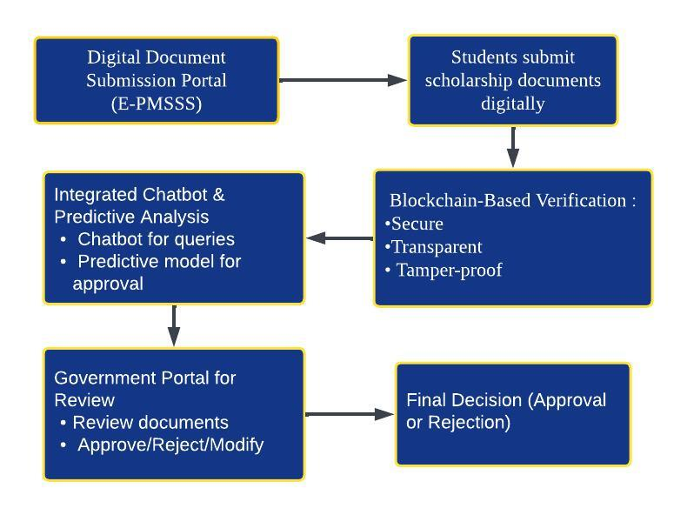
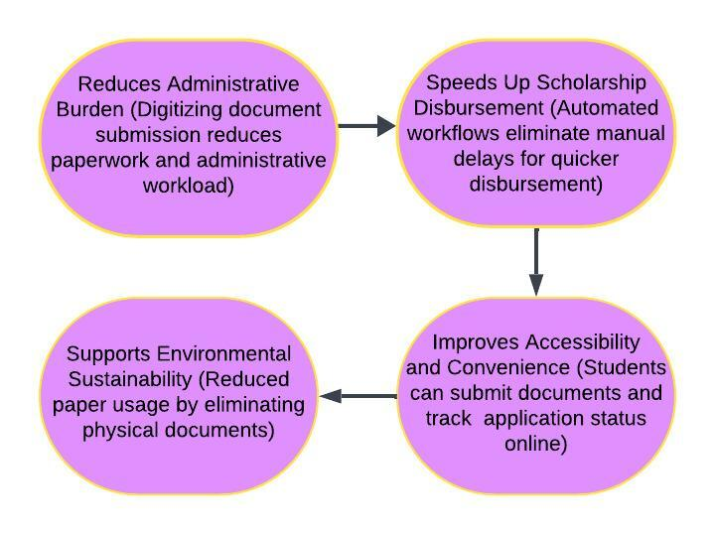
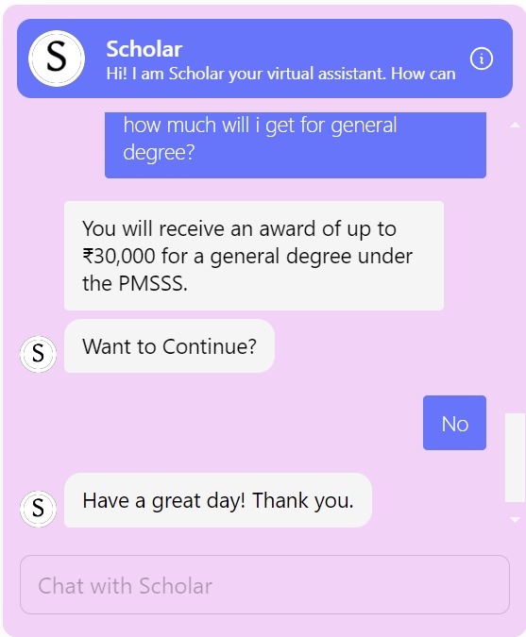
Green Grants
IDEA TITLE
Development of a Paperless Scholarship Disbursement System for PMSSS
Detailed Explanation of the Proposed Solution:
How it addresses the problem:
TECHNOLOGIES USED AND INNOVATION
Frontend:- (HTML, CSS, JS, jQuery, Bootstrap) Backend:- (Python, Django, Solidity, Brownie, Django-Blockchain)
ML: (PyTesseract(OCR),Python Imaging Library(PIL), SCIKIT-LEARN , Random forest classifier)

Slide 3
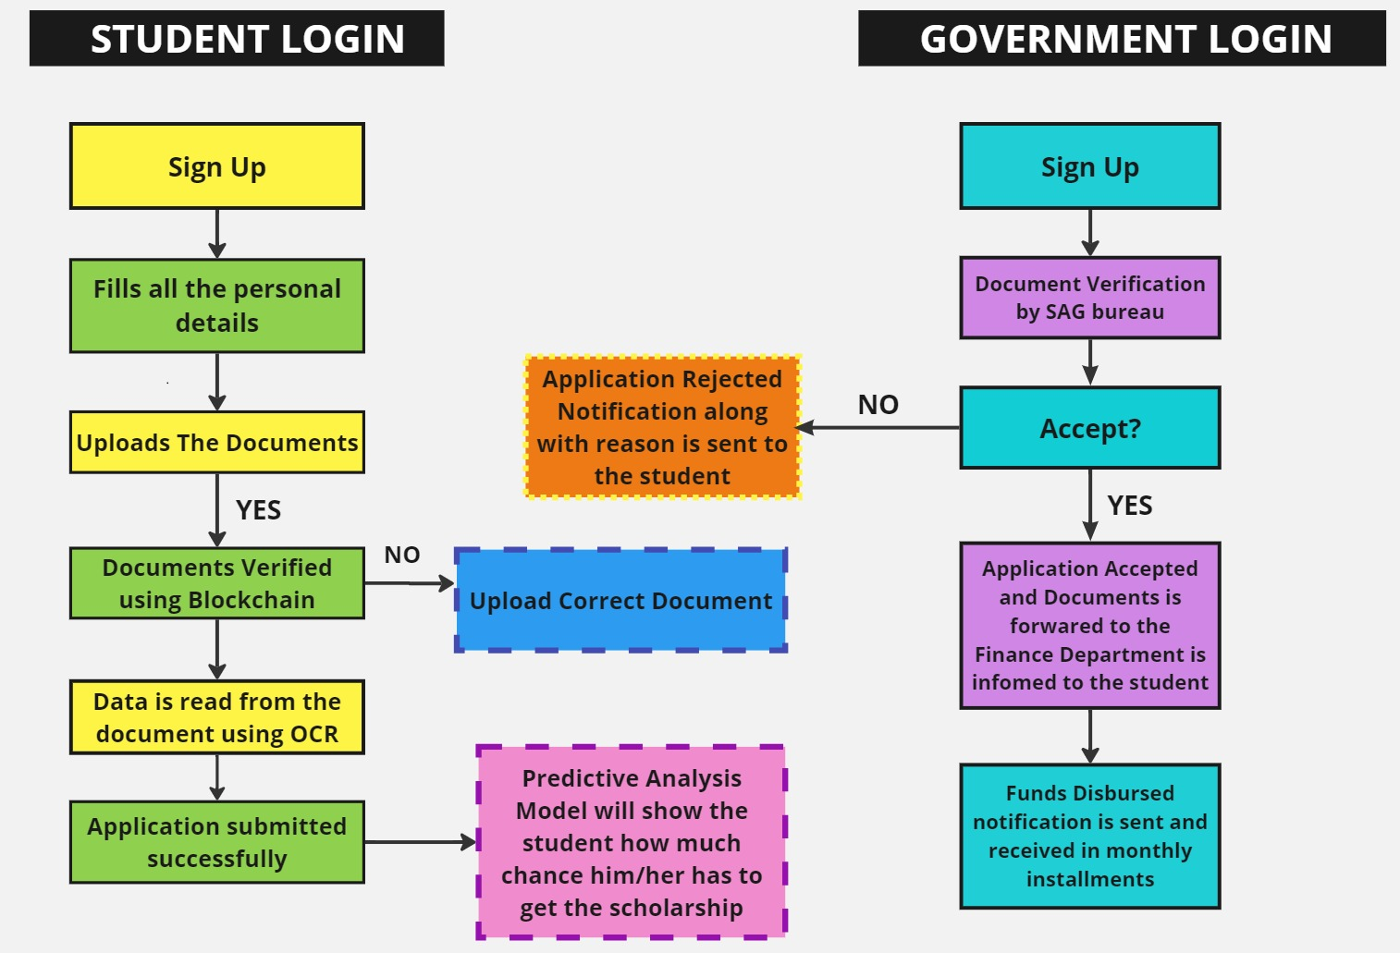
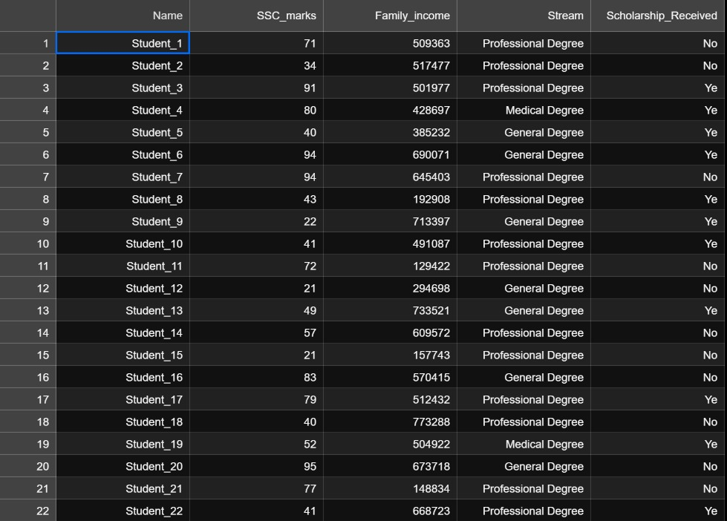
TECHNICAL APPROACH
Green Grants
WORKFLOW DIAGRAM
PREDICTIVE ANALYSIS MODEL

Slide 4
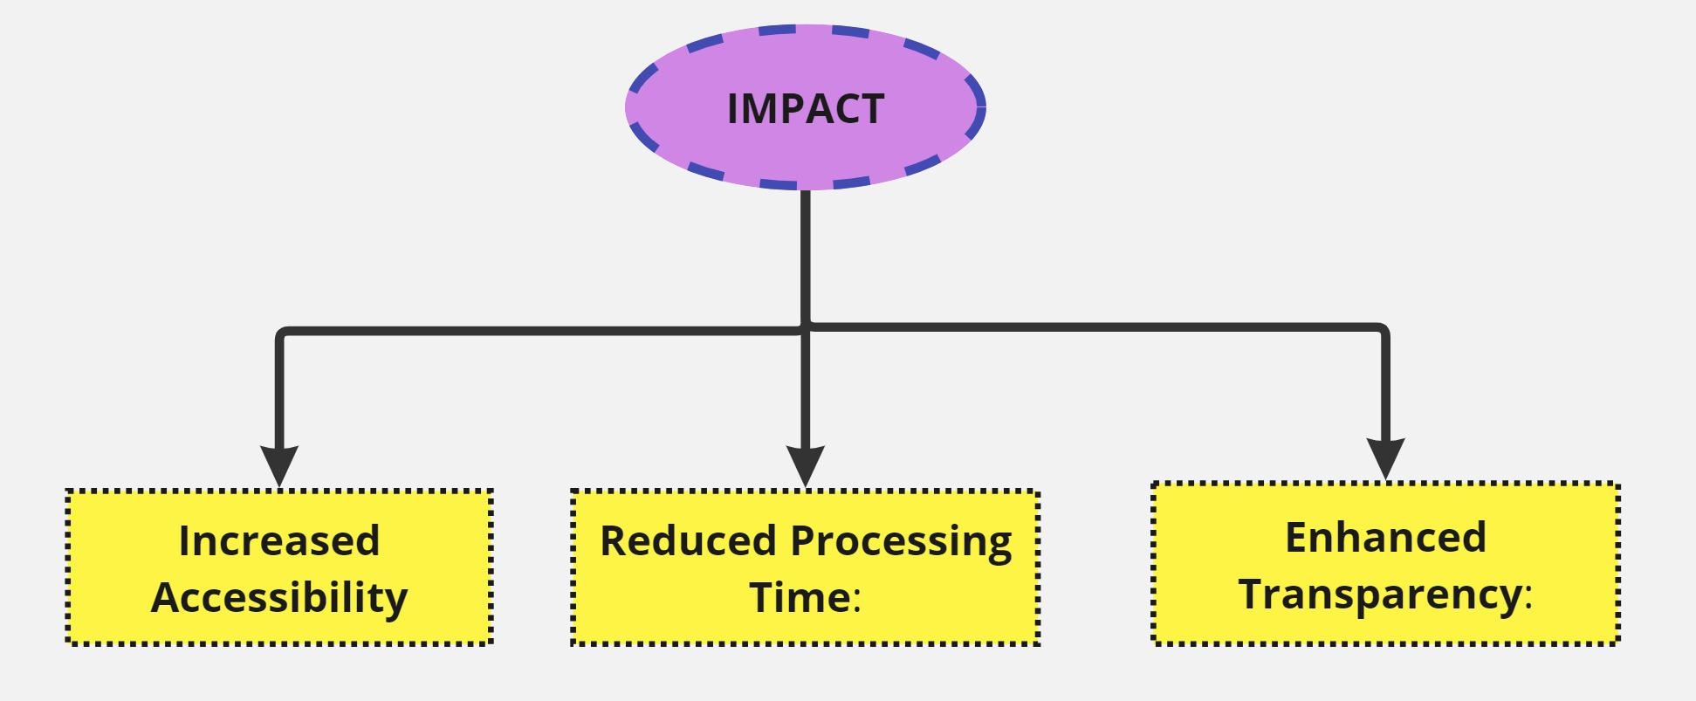
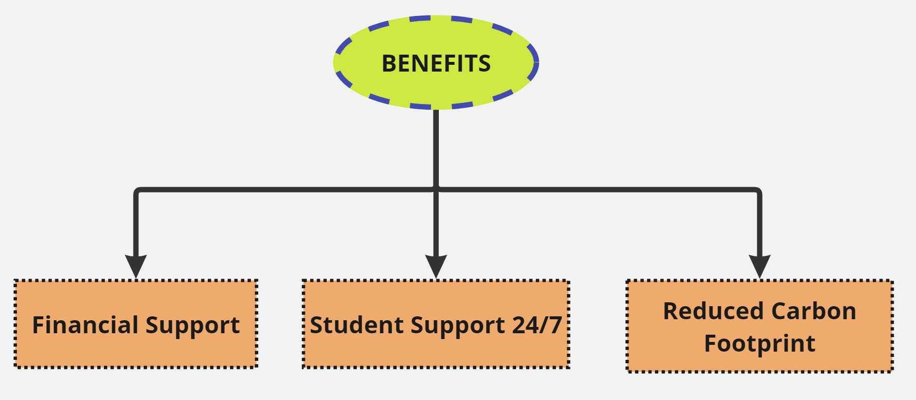
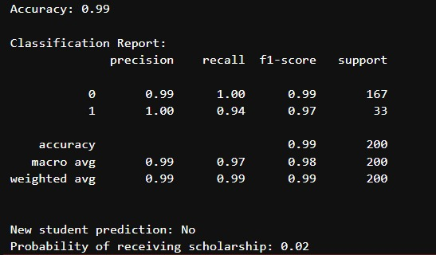
IMPACT & BENEFITS
Green Grants
A predictive analysis model that shows students their likelihood of receiving a scholarship, helping them get a clear idea in advance.
PREDICTIVE ANALYSIS MODEL

Slide 5
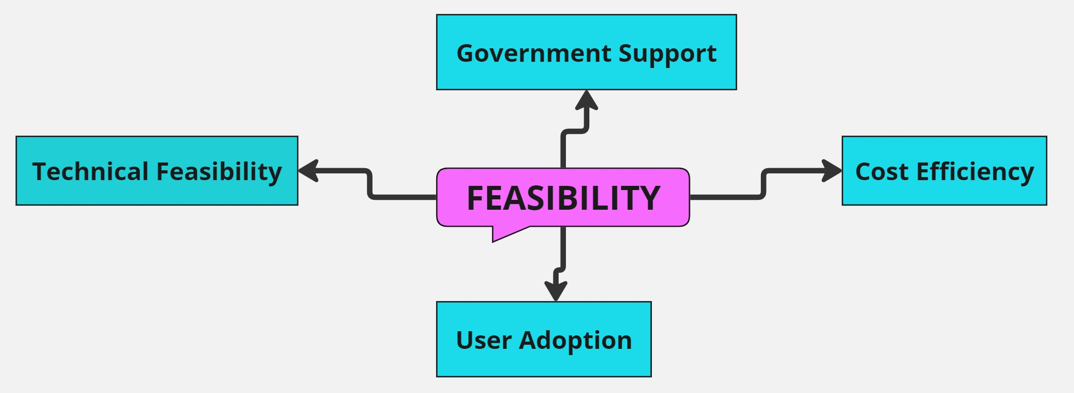
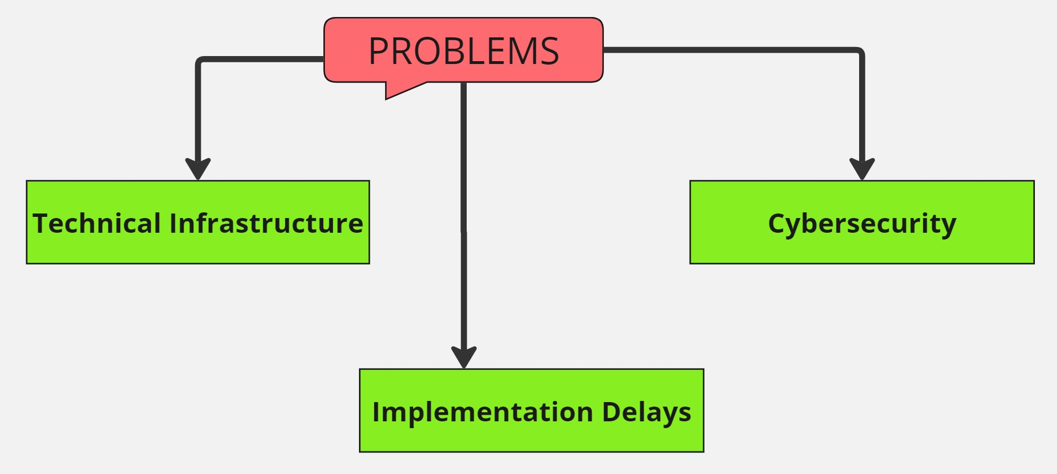
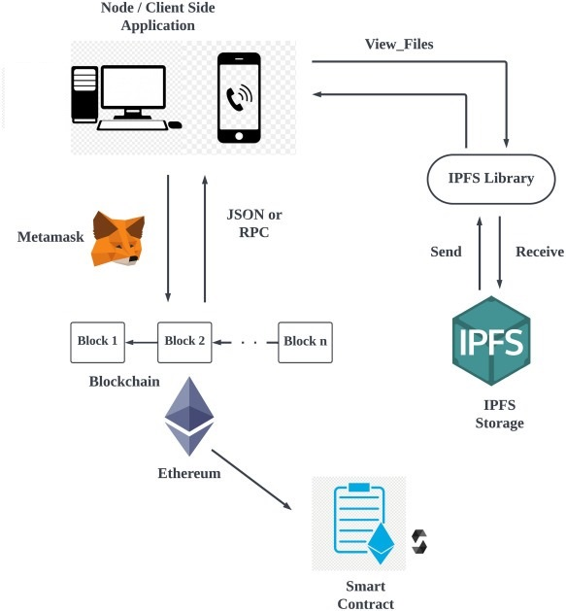


Green Grants
FEASIBILITY AND VIABILITY
ANALYSIS OF FEASIBILITY OF THE IDEA
POTENTIAL CHALLENGES AND RISKS
BLOCKCHAIN DEVELOPMENT TO AVOID RISKS
STRATEGIES FOR OVERCOMING CHALLENGES
Robust Infrastructure
Enhanced Cybersecurity Measures
Model Calibration:

Slide 6
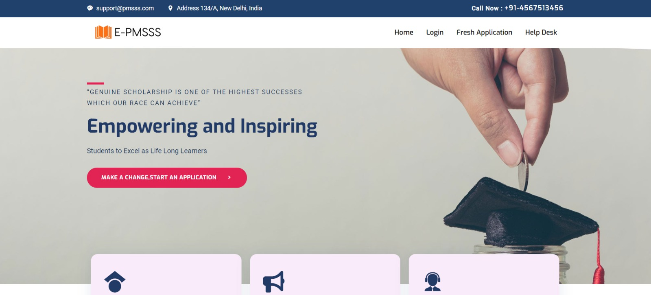
Green Grants
RESEARCH AND REFERENCES
TEAM MEMBERS:
SANDEEP SARKAR
GARVI KAUR
ANANYA ARYA
ADITYA PAUL
ANKIT DEY
JAYASHREE MAJI
https://www.aicte-jk-scholarship-gov.in/
https://www.investopedia.com/terms/p/predictive-analytics.asp
https://www.salesforce.com/in/service/customer-service-chatbot/what-is-a-chatbot/
THANK YOU!

